Slide 1


Team Details
Team name:
Team leader name:
Problem Statement:
Team Details
Team name: Tech Pandas
Team leader name: Harsh Singh
Problem Statement: Smart Supply Chains

Slide 2
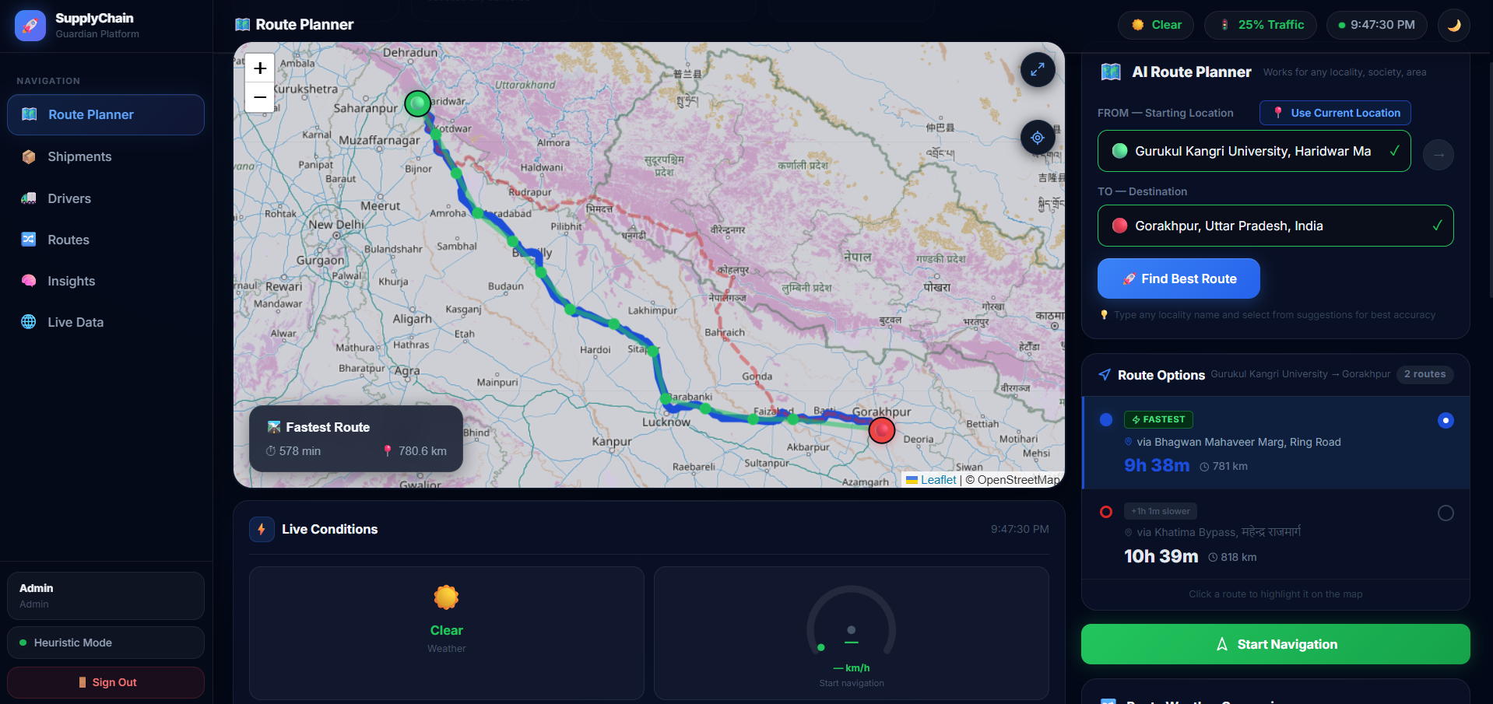
The solution replaces standard geometric routing with a multi-variable optimization formula:
Existing Logic: Min(Distance) — Focuses solely on the shortest physical path.
Our Logic: Min(Time + Risk + Fuel) — Optimizes for speed, cargo safety, and cost-efficiency simultaneously.
Important Note: While existing systems like Google Maps provide traffic data, your solution is purpose-built for Supply Chain Orchestration, meaning it prioritizes shipment priority and driver availability over just "avoiding a red line on a map."

Slide 3
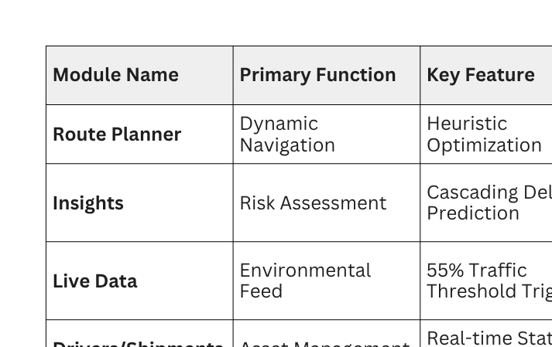
Opportunities
How different is it from any of the other existing ideas?
How will it be able to solve the problem?
The Difference
Most companies use three different pieces of software for these tasks.
This platform uses AI to bridge the gap, ensuring that a "Live Alert" (like the one currently active in your dashboard) automatically informs the Route Planner to optimize the path.

Slide 4
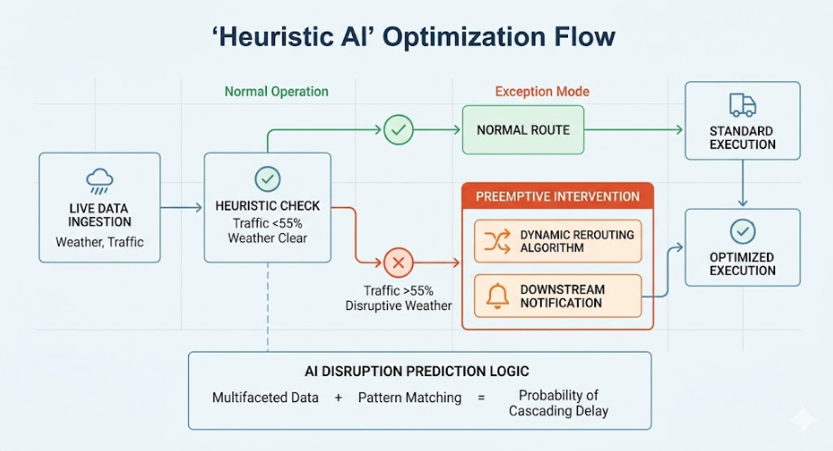
List of features offered by the solution
Core Management Modules
AI Route Planner: A dynamic tool that allows users to input starting locations and destinations to find the most optimized paths. It is designed to work across any locality or city with high accuracy.
Shipment Tracking: A dedicated module to monitor the lifecycle and status of goods in transit.
Driver Management: A system to oversee driver assignments, availability, and performance metrics.
Route Analytics: Provides a high-level overview of active and historical transit paths to identify patterns and inefficiencies.
Insights from MVP

Slide 5
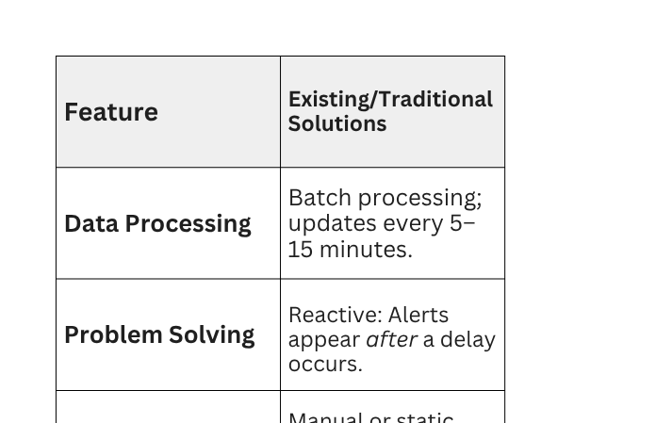
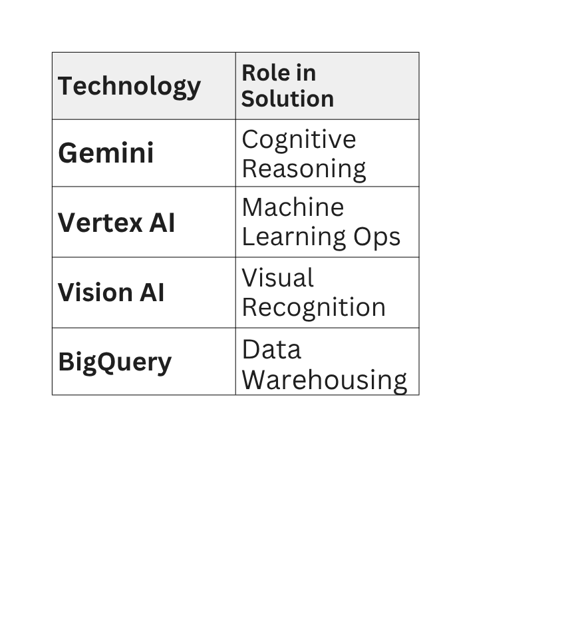
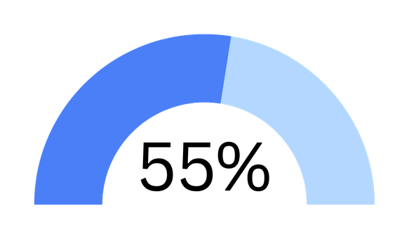
Technology used
Features
Preemptive:
Detects "multifaceted transit data" to flag issues before they happen.
Instantly recommends via AI based on traffic, weather, and 55% traffic thresholds.
Continuous Stream Processing; sub-second live data analysis.
Scalable Cloud-Native:
Designed for high-volume shipment and driver monitoring.

Slide 6
Intelligence & Live Monitoring
Predictive Heuristics: Analyzes data to flag supply chain disruptions before they happen.
Live Environmental Feeds: Real-time monitoring of traffic surges (55%+ thresholds) and weather conditions.
Preemptive Alerts: Visual indicators that warn operators of emerging bottlenecks.
Intelligence & Risk Mitigation
Live Disruption Monitor: Tracks environmental variables, including:
Traffic Thresholds: Identifies surges exceeding 55% density.
Weather Guard: Evaluates risks based on atmospheric conditions (e.g., storms).
Preemptive Alert System: Visual signaling that notifies managers of bottlenecks before they occur.
System Capabilities
Interactive Mapping: High-precision visualization via Leaflet and OpenStreetMap.
Cloud-Native Scale: Built to process massive data streams with zero lag.
Adaptive UI: Responsive dashboard featuring dark mode and streamlined navigation.
Primary Operations Interfaces
AI Route Planner: Generates optimized, real-time paths to bypass local disruptions.
Shipment Tracking Console: Centralized hub for monitoring the end-to-end lifecycle of goods.
Driver Management System: Tracks driver assignments, performance, and availability.

Slide 8


